Slide 1
Network Visualization
Sougata Mukherjea
IIT Delhi

Slide 2
Network Visualization
Introduction to Visualization
Graph Visualization
Graph Layout
Tree Visualization
Interaction
Graphical Excellence
Network Visualization Software

Slide 3
Network Visualization
Introduction to Visualization
Graph Visualization
Graph Layout
Tree Visualization
Interaction
Graphical Excellence
Network Visualization Software

Slide 4
Moving beyond Graph Layout
One of the key ways we move beyond graph layout to graph visualization (InfoVis) is interaction with the graph
Interaction is essential for understanding large graphs
We can utilize various techniques

Slide 5
Interaction
“The effectiveness of information visualization hinges on two things: its ability to clearly and accurately represent information and our ability to interact with it to figure out what the information means.”
S. Few Now You See It, p. 55
What is Interaction?
“The communication between user and the system” [Dix et al., 1998]
“Direct manipulation and instantaneous change” [Becker et al., 1987]
There is too much to be shown
There are many ways to show it
Let the user dynamically control what to show and how to show it

Slide 6
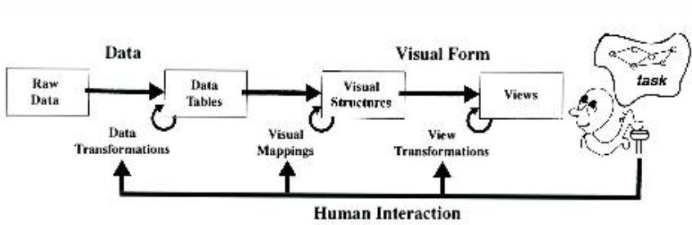
The Visualization Pipeline

Slide 7
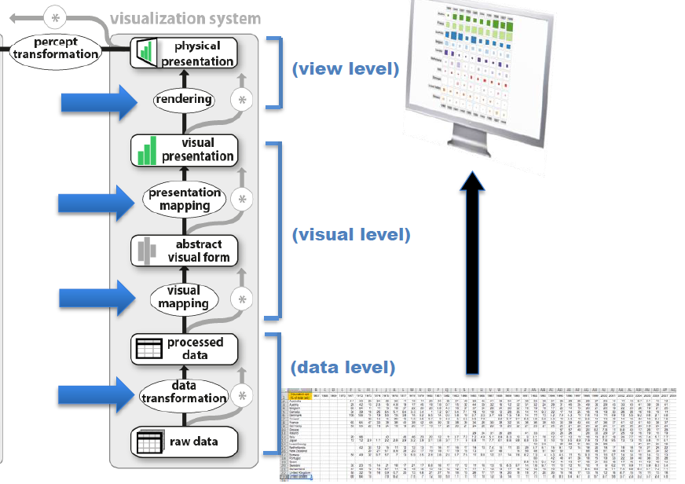

Slide 8
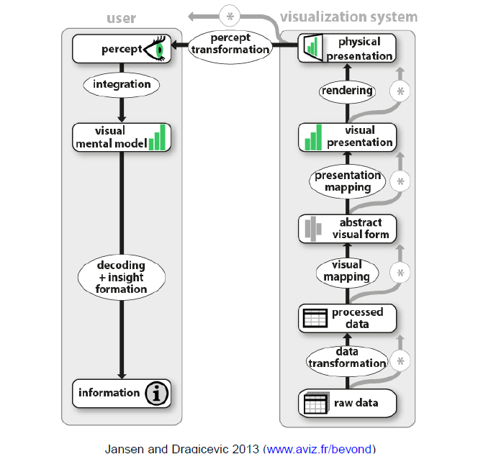

Slide 9
Analytical Tasks
Overview: Gain an overview of the entire collection
Zoom : Zoom in on items of interest
Filter: Filter out uninteresting items
Details-on-demand: Select an item or group and get details when needed
Relate: View relationships among items
History: Keep a history of actions to support undo, replay, and progressive refinement
Extract: Allow extraction of sub-collections and of the query parameters
Shneiderman, 1996

Slide 10
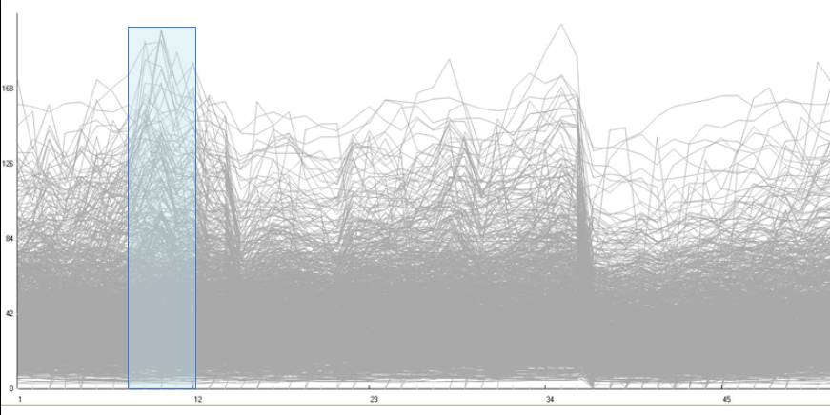
Overview

Slide 11
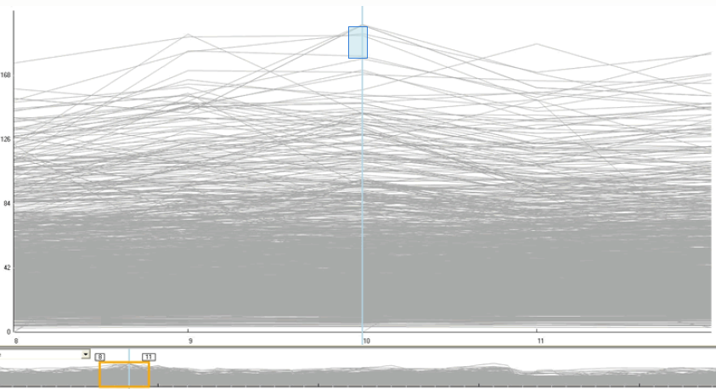
Zoom & Filter

Slide 12
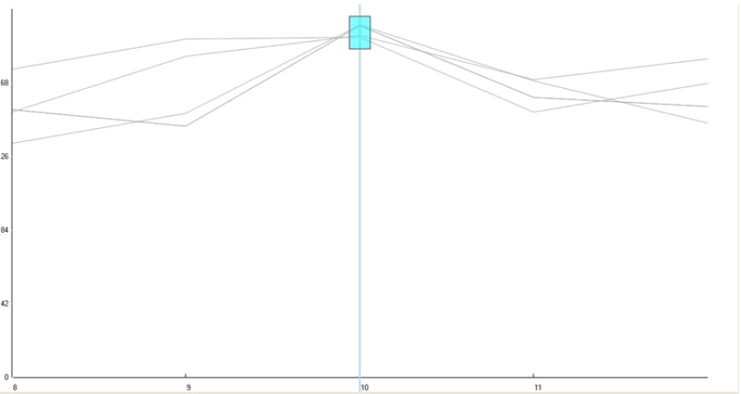
Zoom & Filter

Slide 13
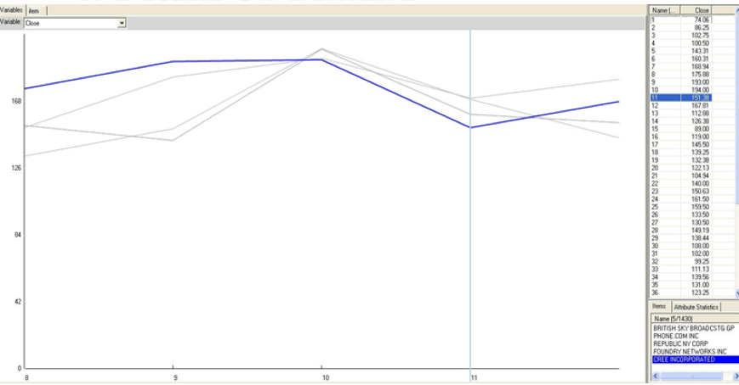
Details on Demand

Slide 14
Interaction Technique
“An interaction technique is the fusion of input and output, consisting of all software and hardware elements, that provides a way for the user to accomplish a task”
Tucker, 2004
Types of interaction techniques
Command-line interfaces
Input: mouse, touch, keyboard, speech,...
Direct manipulation interfaces

Slide 15
Families of Infovis Interaction Techniques
Selection
Rearrangement
Filtering techniques
Navigation techniques
Multiple views

Slide 16
Select
“Mark something as interesting”
Mark items of interest to keep track
Seems to often work as a preceding action to subsequent operations.
Example
Selecting a node in a graph

Slide 17
Rearrangement
“Show me a different arrangement”
Provide different perspectives by changing the spatial arrangement of representation
Example
Change from Node & Link to Matrix representation

Slide 18
Spanning Trees
Graph can be visualized through minimum spanning trees
Additional edges added later
Very common technique
Helps with predictability
Visualization depends on starting point

Slide 19
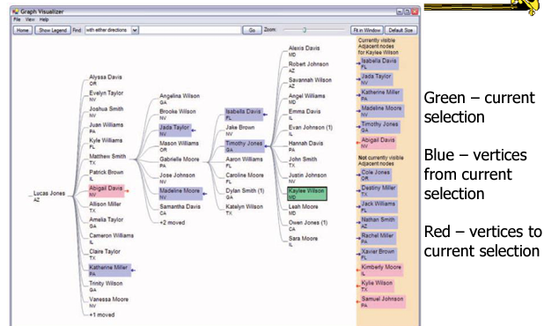
Tree Plus
Don’t draw entire graph
Have a focus vertex, then incrementally expand and show connections (min span tree) from there.
Interaction:
Singleclick: Show connections via highlight
Doubleclick: New focus vertex
Smooth animated change in focus
“Plant a seed and watch it grow”
Lee et al TVCG ‘06

Slide 20
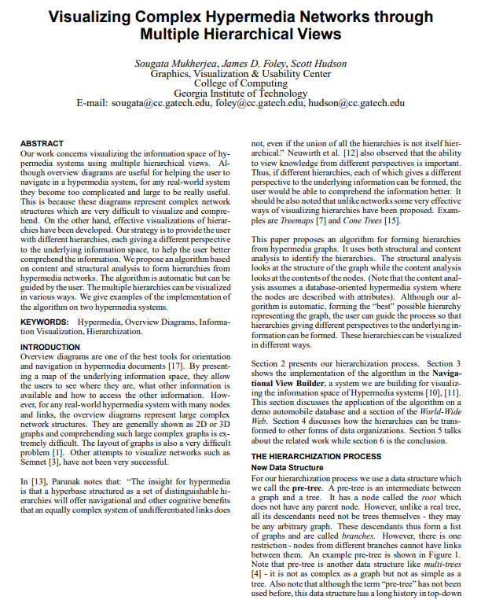

Slide 21
Filtering
“Show me something conditionally”
Change the set of data items being presented based on some specific conditions.
Example
Dynamic query

Slide 22
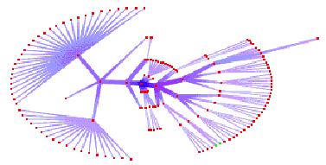
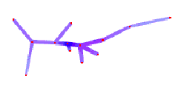
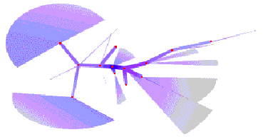
Methods of representing unselected nodes
Ghosting
De-emphasizing or relegating nodes to background
Hiding
Not displaying at all
Grouping
Grouping under super-node representation

Slide 23
Clustering
Structure-based Clustering
Most common in graph visualization
Often retain structure of graph
Useful for user orientation
Content-based Clustering
Application specific
Can be used for
Filtering: de-emphasis or removal of elements from view
Search: emphasis of an element or group of elements

Slide 24
Clustering – Goal & Technique
Common goal
Finding disjoint clusters
Finding overlapping clusters
Common technique
Least number of edges between neighbors
(Ratio Cut technique in VLSI design)

Slide 25
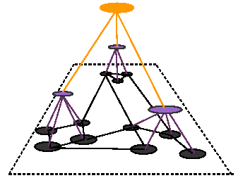
Hierarchical Clustering
From successive application
of clustering process
Can be navigated as tree

Slide 26
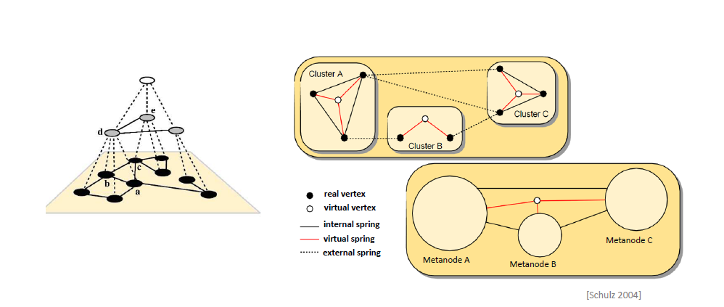
Addressing Computation Scalability

Slide 27
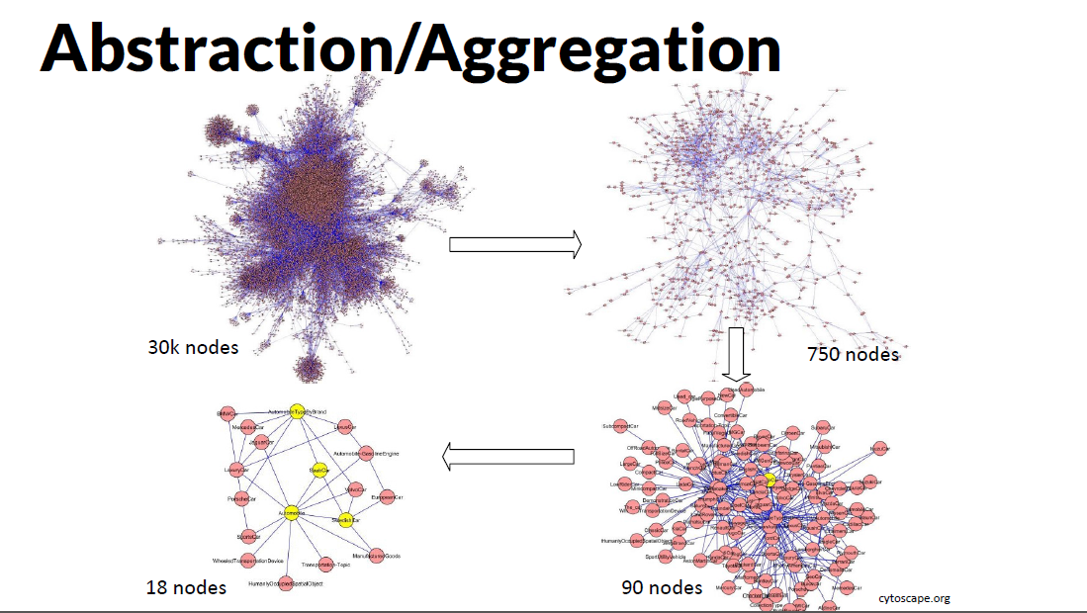

Slide 28
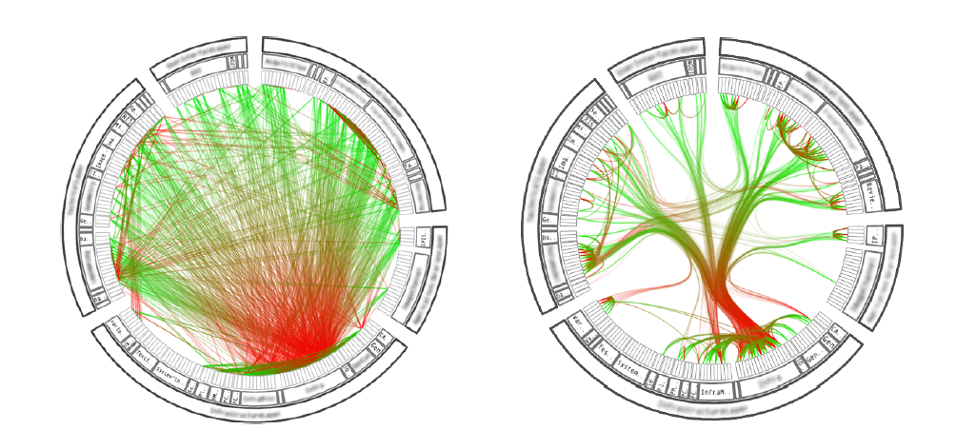
Reduce Clutter: Edge Bundling

Slide 29
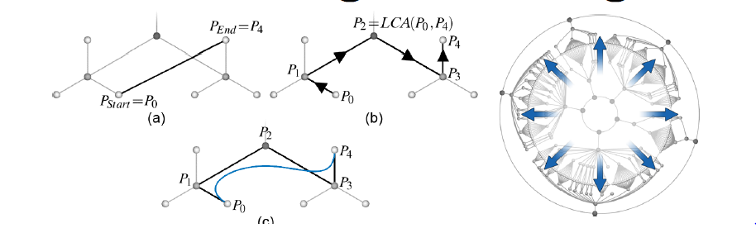
Hierarchical Edge Bundling
Bundle edges that go from/to similar nodes together
Holten TVCG (InfoVis) ‘06
Straight line connection between P0 and P4
Path along the hierarchy between P0 and P4
Spline curve depicting the connection between P0 and P4 by using the path from (b) as the control polygon.

Slide 30
Families of Infovis Interaction Techniques
Selection
Rearrangement
Filtering techniques
Navigation techniques
Multiple views

Slide 31
Pan & Zoom
Zoom and Pan
Zoom for graphs exact, not pixel-based (adjustment of screen transformations)
Geometric Zooming
Simple blow-up
Semantic Zooming
Content changes
Clustering

Slide 32
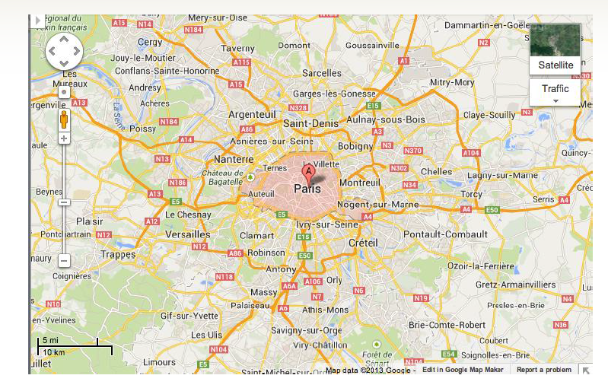
Pan & Zoom

Slide 33
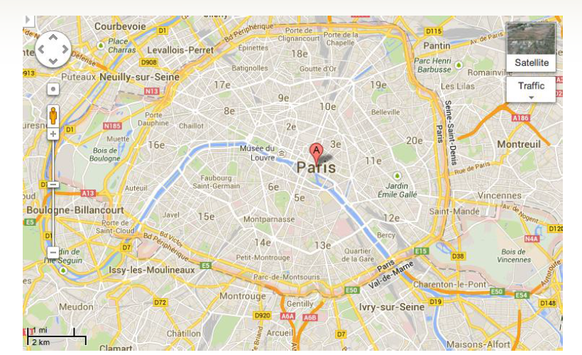
Pan & Zoom

Slide 34
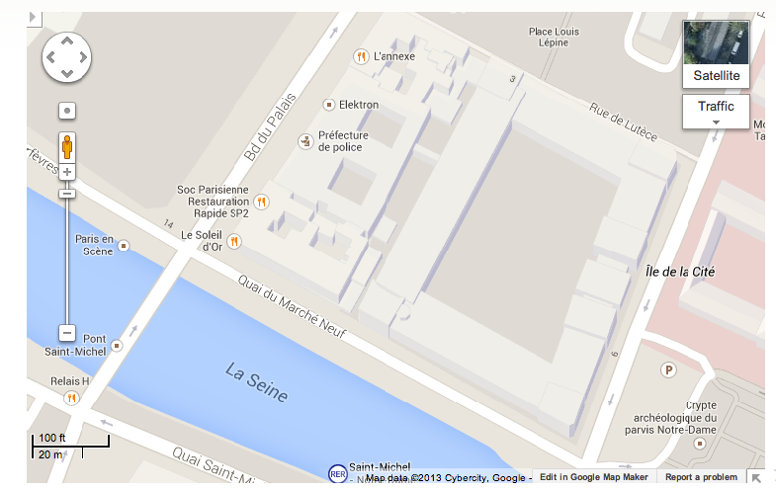
Pan & Zoom

Slide 35
Problem – Where am I?

Slide 36
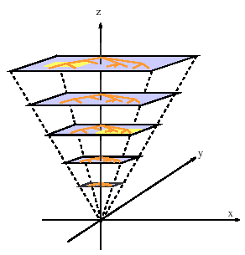
Problem with Combination of Zoom and Pan
Assume zoom and pan independent
Objects may temporarily move away
Semantic Zoom: Picture differs for each level

Slide 37
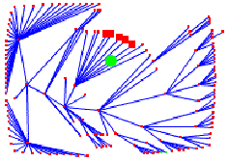
Focus + Context Techniques
Zooming looses contextual information
Focus + Context keeps context
Example: Fisheye Distortion

Slide 38
Degree of Interest
Concept introduced in classic paper
“Generalized fisheye views” George Furnas, 1986
Definition :
DOI_{fisheye}(x|y) = API(x) – D(x,y)
x is any node
y is current point of focus
API(x) is the global A Priori Importance
D(x,y) is the Distance between x and the current point y

Slide 39
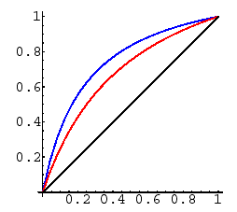
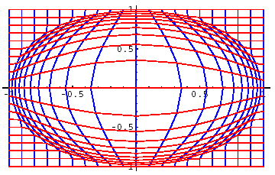
Fisheye Distortion
Process
Pick focus point
Map points within radius using a concave monotonic function
Example: Sarkar-Brown distortion function

Slide 40
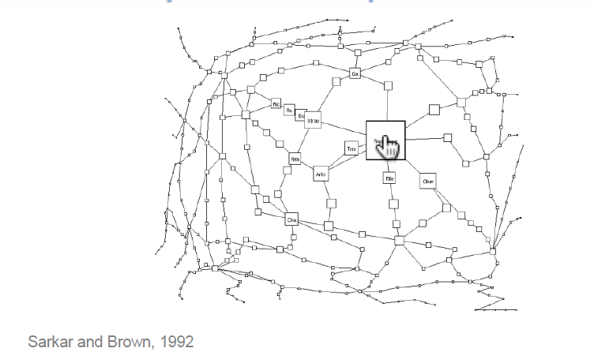
Focus + Context
Fisheye View of Graphs

Slide 41
Problem with Fisheye
Distortion should also be applied to links
Prohibitively slow (polyline)
Alternative:
Continue using lines
Can result in unintended line crossings
Other Alternative
Combine layout with focus + context
Hyperbolic viewer

Slide 42
Euclidean Geometry - Postulates
A straight line segment may be drawn from any given point to any other.
A straight line may be extended to any finite length.
A circle may be described with any given point as its center and any distance as its radius.
All right angles are congruent.
If a straight line intersects two other straight lines, and so makes the two interior angles on one side of it together less than two right angles, then the other straight lines will meet at a point if extended far enough on the side on which the angles are less than two right angles.

Slide 43
Parallel Postulate (Postulate 5)
Cannot be proven as theorem
Some equivalent properties
There is at most one line that can be drawn parallel to another given one through an external point. (Playfair's axiom)
The sum of the angles in every triangle is 180°
Two lines that are parallel to the same line are also parallel to each other.

Slide 44
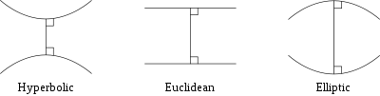
Non-Euclidean Geometry
Replacing Parallel Postulate gives rise to Hyperbolic and Elliptic Geometry
Behavior of lines with a common perpendicular in each of the three types of geometry

Slide 45
Hyperbolic and Elliptic Geometry
Hyperbolic Geometry
For any given line l and point P not on l, in the plane containing both line l and point P there are at least two distinct lines through P that do not intersect l.
Elliptic Geometry
For any given line l and a point P, which is not on l, all lines through P will intersect l.

Slide 46
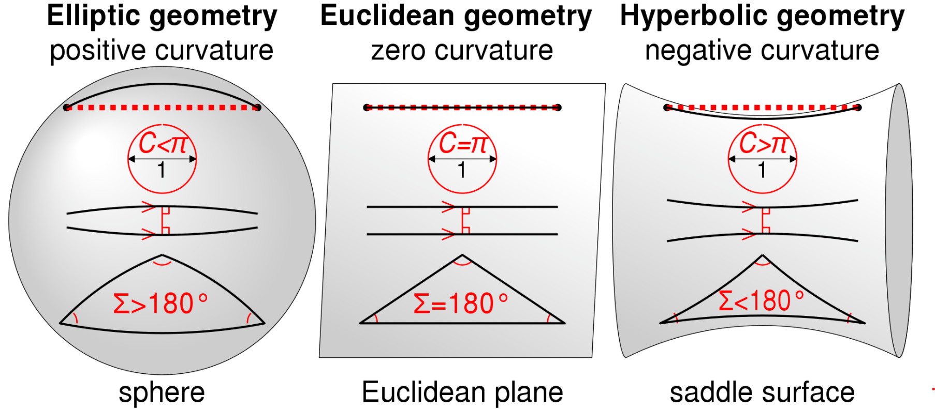

Slide 47
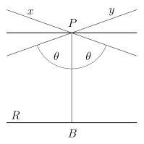
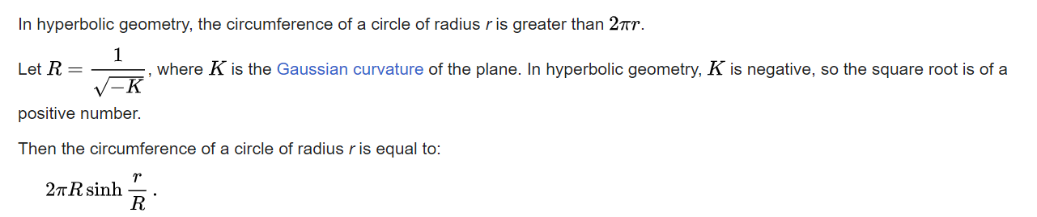
Hyperbolic Geometry
Lines
For any line R and any point P here are through P an infinite number of coplanar lines that do not intersect R.
Circle
Lines through a given point P and asymptotic to line R.

Slide 48
Hyperbolic Browser
Focus + Context Technique
Detailed view blended with a global view
First lay out the hierarchy on the hyperbolic plane
Then map this plane to a disk
Start with the tree’s root at the center
Use animation to navigate along this representation of the plane

Slide 49
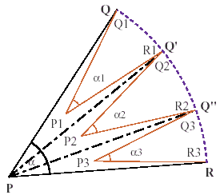
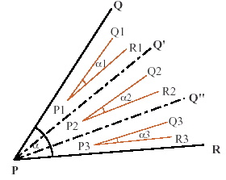
Simple Tree Construction Algorithm
Node P with wedge QPR
Subtrees start at P₁, P₂, and P₃
The circumference of a circle grow exponentially with its radius
Euclidean Hyperbolic

Slide 50
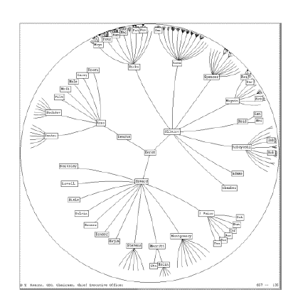
2D Hyperbolic Browser
Approach: Lay out the hierarchy on the hyperbolic plane and map this plane onto a display region.
Comparison
A standard 2D browser: 100 nodes (w/3 character text strings)
Hyperbolic browser: 1000 nodes, about 50 nearest the focus can show from 3 to dozens of characters

Slide 51
Hyperbolic Browser - Concepts
Natural magnification(fisheye) in center
Layout depends only on 2-3 generations from current node
Smooth animation for change in focus
Don’t draw objects when far enough from root (simplify rendering)

Slide 52
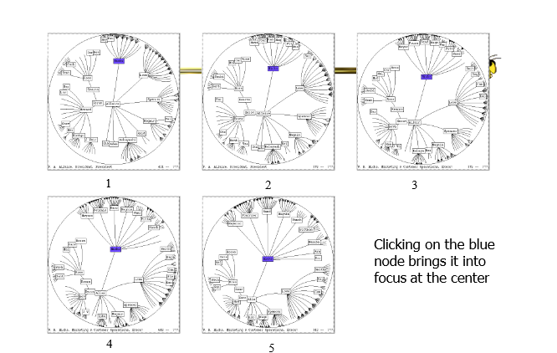
Hyperbolic Browser - Interactions

Slide 53
Hyperbolic Browser - Problems
Orientation
Watching the view can be disorienting
When a node is moved, its children don’t keep their relative orientation to it as in Euclidean plane, they rotate
Not as symmetric and regular as Euclidean techniques, two important attributes in aesthetics

Slide 54
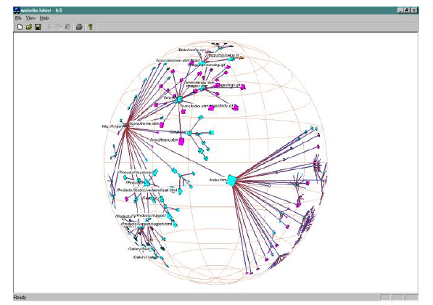
H3Viewer – Viewing Graphs in 3D Hyperbolic Space

Slide 55
H3 Viewer - Technique
Find a spanning tree from an input graph
Layout algorithm
Nodes are laid out on the surface of a hemisphere
A bottom up pass to estimate the radius needed for each hemisphere
A top down pass to place each child node on its parental hemisphere’s surface

Slide 56
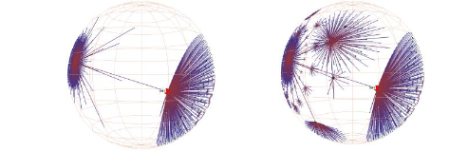
H3 Viewer - Drawing
Showing less of the context surrounding the node of interest during interactive browsing
Fill in more of the surrounding scene when the user is idle

Slide 57
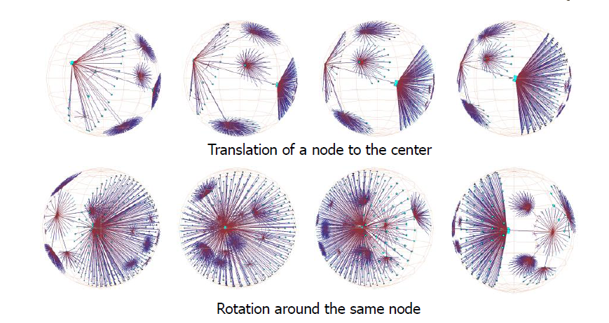
H3 Viewer - Navigation

Slide 58
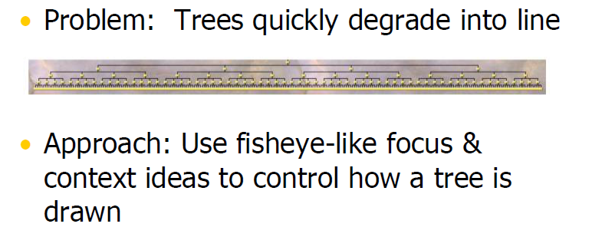
Degree of Interest Trees

Slide 59
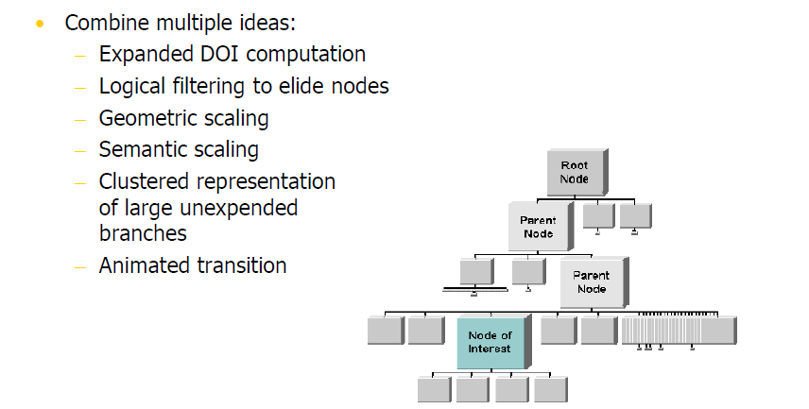
Approach

Slide 60
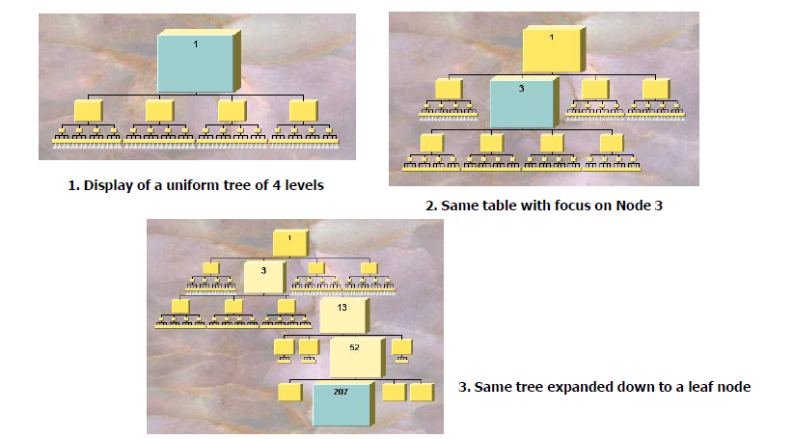
Example

Slide 61
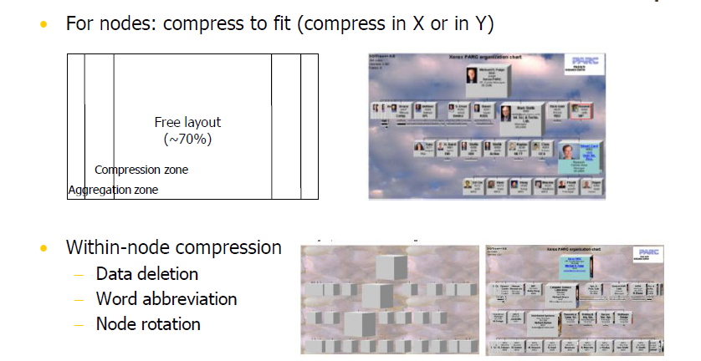
Compression

Slide 62
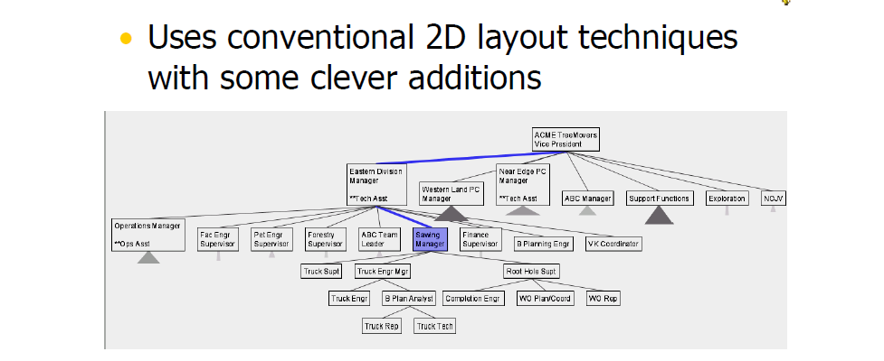
Space Tree
Subtrees are triangles
Size indicates depth
Shading indicates number of nodes inside
Navigate by clicking on nodes

Slide 63
Families of Infovis Interaction Techniques
Selection
Rearrangement
Filtering techniques
Navigation techniques
Multiple views

Slide 64
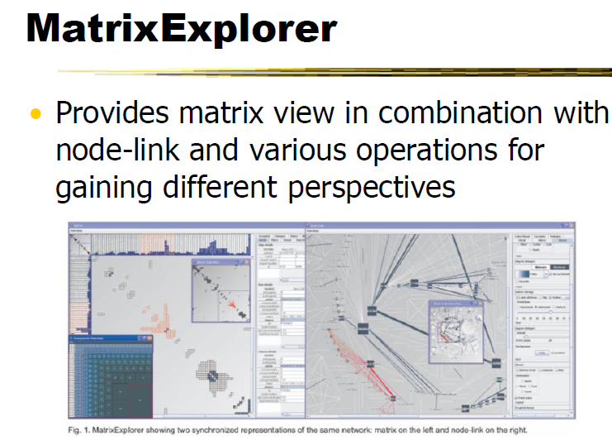
Multiple Views

Slide 65
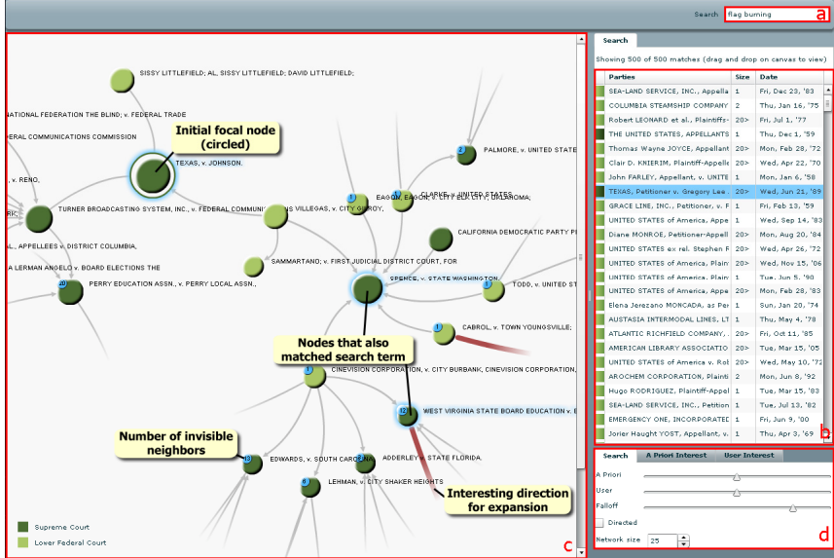
Multiple Views – Search & Visualization
“Search, show context, expand on demand”
Show some of the details, rather than high level structure
Allow users to focus on particular nodes
Adapt DOI algorithm from trees to graphs
Rely heavily on interaction
Basic user interface layout. A user types a query in the searchbox which yields a number of hits presented in tabular form
One of these hits can then be dragged to the main screen which shows the subgraph centered on that node. Other nodes that matched the user’s search are highlighted in blue.
Users can adapt the balance between different components of the DOI function and the size of the subgraph in a separate panel.
van Ham & Perer TVCG (InfoVis) 2009

Slide 66
Social Action
Combines graph structural analysis (ranking) with interactive visual exploration
Multiple coordinated views
Lists by ranking for analysis data
Basic force-directed layout for graph vis
Perer & Shneiderman TVCG (InfoVis) ‘06

Slide 67
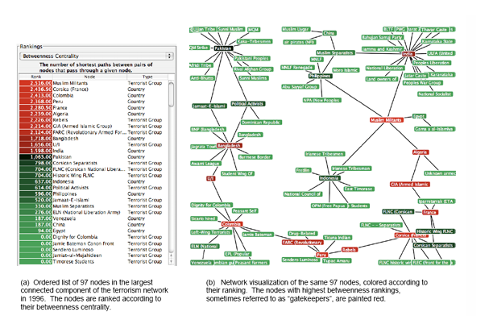
Multiple Coordinated Views

Slide 68
Social Network Attributes
Bary center – total shortest path of a node to all other nodes
Betweenness centrality – how often a node appears on the shortest path between all other nodes
Closeness centrality – how close a node is compared to all other nodes
Cut-points – the subgraph becomes disconnected if the node is removed
Degree – number of connections for node
Power centrality – how linked a node is to rest of network
HITs – “hubs and authorities” measure
Page Rank – number and quality of in-links

Slide 69
Attribute Ranking
Run these measures on all nodes and rank them
Sort the rankings and show in lists and scatterplots
Allow user to filter based on rankings
Can aggregate rankings for cohesive subgroups of nodes

Slide 70
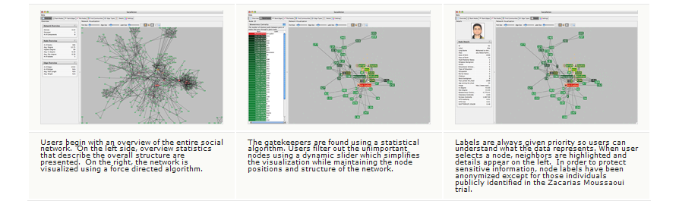
Visual Analysis

Slide 71
Readings
D. Holten. Hierarchical edge bundles: Visualization of adjacency relations in hierarchical data. IEEE Trans. on Visualization and Computer Graphics, 2006. Available at: https://www.researchgate.net/publication/6715561
Lamping and Rao. The Hyperbolic Browser: A Focus + Context Technique for Visualizing Large Hierarchies. Journal of Visual Languages & Computing, March 1996. Available at: https://www.researchgate.net/publication/220578919
T.Munzner. H3: Laying Out Large Directed Graphs in 3D Hyperbolic Space. Proceedings of the 1997 IEEE Symposium on Information Visualization, 1997. Available at: https://graphics.stanford.edu/papers/h3/
Card and Nation. Degree-of-interest trees: A component of an attention-reactive user interface. Proceedings of the Working Conference on Advanced Visual Interfaces. May 2002. Available at: https://www.researchgate.net/publication/228685532
A. Perer, B. Shneiderman. Balancing Systematic and Flexible Exploration of Social Networks, IEEE Trans. on Visualization and Computer Graphics, 2006. Available at: https://www.researchgate.net/publication/6715555

Slide 72
Network Visualization
Introduction to Visualization
Graph Visualization
Graph Layout
Tree Visualization
Interaction
Graphical Excellence
Network Visualization Software

Slide 73
Features of good Graphical Displays - Tufte
They should show the data.
They should encourage the user to think about the substance of the data.
They should make large datasets coherent to the reader.
They should reveal the data at several levels of detail.
They should avoid distorting what the data have to say.
They should serve a reasonably clear purpose: description, exploration, tabulation or decoration
They should be closely integrated with the statistical and verbal descriptions of a data set

Slide 74
Principals of Graphical Excellence - Tufte
Graphical excellence is the well-designed presentation of interesting data—a matter of substance, of statistics, and of design.
Graphical excellence consists of complex ideas communicated with clarity, precision and efficiency.
Graphical excellence is that which gives to the viewer the greatest number of ideas in the shortest time with the least ink in the smallest space.
Graphical excellence is nearly always multivariate.
And graphical excellence requires telling the truth.

Slide 75
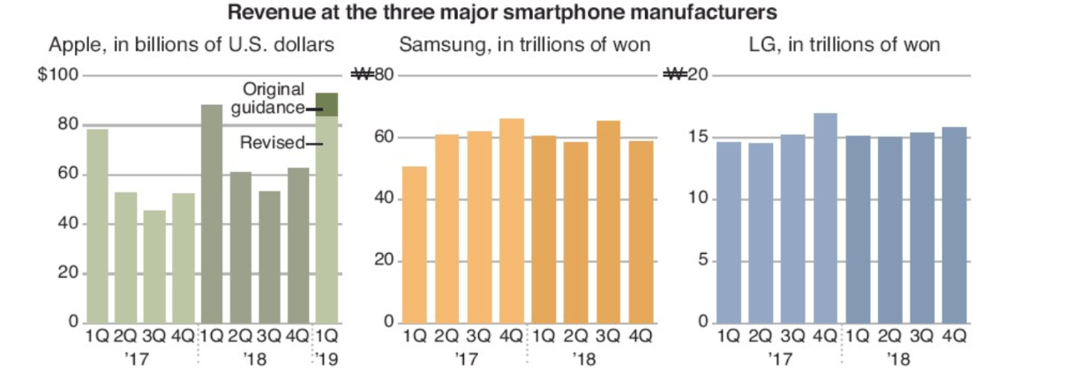
What is wrong?

Slide 76
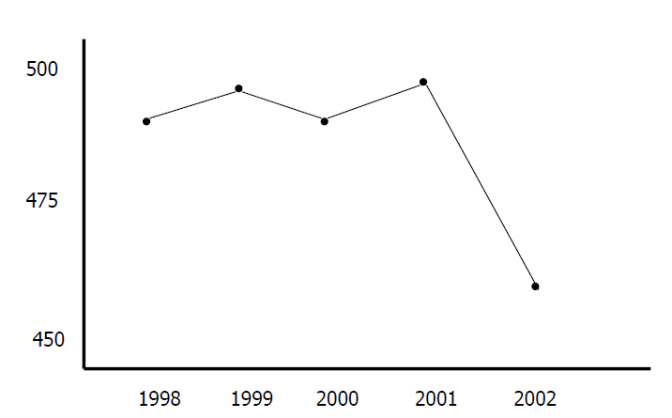
Graphical Integrity

Slide 77
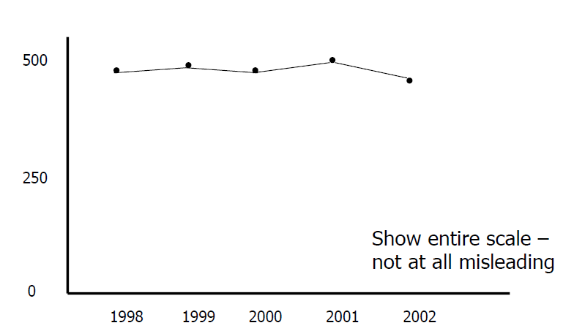
Scale

Slide 78
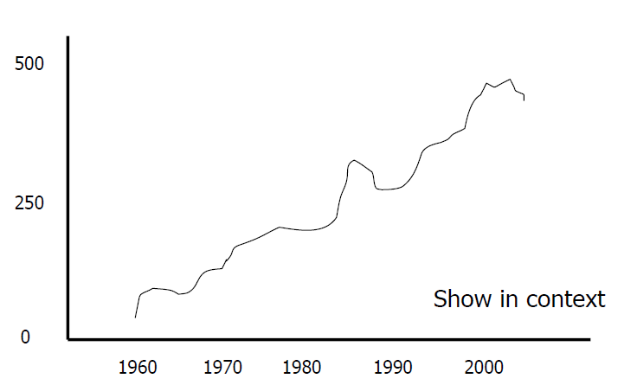
Context

Slide 79
Measuring Misrepresentation
Visual attribute value should be directly proportional to data attribute value
Lie factor = (Size of effect shown in graphic)/(Size of effect in data)

Slide 80
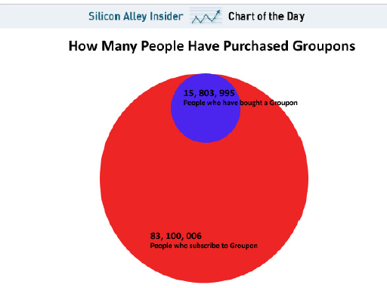
Lie Factor
Graphical area ratio ~9.7
Data ratio ~5.3
Lie factor 9.7/5.3 = 1.8

Slide 81
Design Aesthetics
Set of principles to help guide designers
Maximize data-ink ratio
Maximize data density
Content is king
Avoid “Chart Junk”
Be careful with color

Slide 82
Maximize data-ink ratio
Data ink ratio = (Data ink)/(Total ink used in graphic)
= the ratio of elements in a visual representation conveying information to the total elements in the visualization
= 1 – (proportion of graphic data that can be erased without loss of information)
Data ink ratio can be used to make sure that all the elements displayed in a visualization are relevant to the information being displayed and that no element in the chart be redundant.

Slide 83
Reasons for low data-ink ratio
The use of 3-D effects and shadow effects in a data visualization doesn’t add any extra information. Hence, it decreases the data-ink ratio.
The use of background images can also be unnecessary in the visualizations and may decrease the data-ink ratio.
Unnecessary borders and grid lines don’t convey any information to the user. Most of the time, grids and borders are redundant and decrease the data-ink ratio.
Adding redundant legends, bold labels, and other decorative elements also reduces the data-ink ratio.

Slide 84
Tufte’s 5 Laws of Data Ink
Show the data: Keep in mind that we need to show the data to the viewer. Hence, we should show all the relevant data in the chart. The data should be the number one priority.
Maximize the data-ink ratio: While presenting the data, we should focus on maximizing the data-ink ratio.
Erase non-data ink: To increase the data-ink ratio, we should erase all the elements of the visualization that don’t contribute any information like 3-D effects, grids, annotations, colors, and borders.
Erase redundant data ink: We should also delete the elements that show redundant data from the visualization. The elements that often fall in this category are legends, labels, and information unrelated to the visualization.
Revise and edit: While creating any visualization, we should critically evaluate it and make sure that we have proper elements in the visualization and that there is no redundancy.

Slide 85

Data-Ink Ratio

Slide 86

Bar Chart - Bad

Slide 87

Bar Chart - Good

Slide 88


Data Density
Data Density = (Number of entries in data matrix)/(Area of data graphic)
Good Data Density
Bad Data Density

Slide 89
Maximize Data Density
“Data-rich designs give a context and credibility to statistical evidence. Low-information designs are suspect: what is left out, what is hidden, why are we shown so little? High-density graphics help us to compare parts of the data by displaying much information within the view of the eye: we look at one page at a time and the more on the page, the more effective and comparative our eye can be. The principle, then, is: Maximize data density and the size of the data matrix, within reason.”
Edward Tufte

Slide 90
Content is King
Avoid separate legends and keys -- Just have that information in the graphic
Make grids, labeling, etc., very faint so that they recede into background
Integrate text, chart, graphic, map into a coherent narrative

Slide 91


Slide 92

Avoid chart junk
Extraneous visual elements that detract from message

Slide 93
Use Color to Communicate, not to Decorate!
To differentiate information marks (red states, blue states)
To show continuous variation of a value (as in temperature range)
To call attention/highlight
“The often scant benefits derived from coloring data indicate that even putting a good color in a good place is a complex matter. Indeed, so difficult and subtle that avoiding catastrophe becomes the first principle in bringing color to information: Above all, do no harm.”
Tufte

Slide 94

Color should be used to communicate

Slide 95

Color Contrast for Visibility

Slide 96

Use Soft Colors
Use mostly soft colors, with strong contrasting colors for emphasis
Different shades of gray are colors too!

Slide 97

Ordered Hues are meaningful

Slide 98

Do not use fancy visual effects

Slide 99

Labeling
Labeling is difficult to do when so many entities exist
Exentric Labeling: Does not appear until user hovers over data points

Slide 100
Avoid Bad Visualizations - Graph
The hairball – showing connections that are so dense, they can’t be usefully visualized.
The snowstorm – packed with many small, separate components where nothing stands out.
The starburst – where almost every connection is between a single central node and every other node.

Slide 101



Avoid Bad Visualizations - Graph

Slide 102
Books on Design Principles
Tufte, The Visual Display of Quantitative Information (Best 100 books of 20th century – Amazon)
Tufte, Envisioning Information
Tufte, Visual Explanations
Few, Now you see it

Slide 103
Network Visualization
Introduction to Visualization
Graph Visualization
Graph Layout
Tree Visualization
Interaction
Graphical Excellence
Network Visualization Software

Slide 104
Introduction
There are many tools available for Visualization and Analysis of graphs.
Two Types:
Systems providing visualizations
Toolkits and Libraries that can be used to build systems
Some are Commercial systems (Many have free basic versions)

Slide 105
Systems providing visualizations
Gephi
Pajek
Guess
TouchGraph
Pollinode
NodeXL
Many more!

Slide 106


Slide 107

Pajek
Pajek is a program package for analysis and visualization of large networks (networks containing up to one billion of vertices, there is no limit—except the memory size—on the number of lines).
It has been available for 20 years.
The program, documentation and supporting material can be downloaded and used for free for noncommercial use from its web page: http://mrvar.fdv.uni-lj.si/pajek/

Slide 108

NodeXL
NodeXL is a network analysis and visualization software package for Microsoft Exce
The software contains network visualization, social network analysis features, access to social media network data importers, advanced network metrics, and automation.
https://nodexl.com/
Basic version is free

Slide 109

Guess (The Graph Exploration System)
GUESS is an exploratory data analysis and visualization tool for graphs and networks.
The system contains a domain-specific embedded language called Gython (an extension of Python, or more specifically Jython) which supports the operators and syntactic sugar necessary for working on graph structures in an intuitive manner.
An interactive interpreter binds the text that you type in the interpreter to the objects being visualized for more useful integration.
GUESS also offers a visualization front end that supports the export of static images and dynamic movies.
Because GUESS is Jython/Java based user can construct applications and applets without much coding
http://graphexploration.cond.org/
GUESS is distributed as GPL
Makes use of a number of open-source packages and contributions

Slide 110
TouchGraph
TouchGraph allows for the creation and navigation of ineractive graphs.
Commercial system
http://www.touchgraph.com
Older free system for a set of interfaces for graph visualization
http://sourceforge.net/projects/touchgraph/

Slide 111

Pollinode
Polinode allows you to import, collect and analyze network data.
With Polinode Networks you can upload any network data to the Polinode cloud where you can interact with it, visualize it and analyze it.
There is free, basic and professional versions
https://www.polinode.com

Slide 112
Toolkits & Libraries
Set of components or capabilities that allow others to put together visualization systems
Coherent software architecture and set of programming components
Capabilities in graph layout, color management, labeling, dynamic queries, …
Capabilities to calculate metrics (example, Social Network metrics)
Advantage: Much more control
Disadvantage: Learning curve

Slide 113
Toolkits & Libraries
Cytoscape (Java)
GraphViz (Python)
SNAP (C++/Python)
Network X (Python)
iGraph (C)

Slide 114
Cytoscape
Cytoscape is an open source software platform for visualizing molecular interaction networks and biological pathways and integrating these networks with annotations, gene expression profiles and other state data.
Although Cytoscape was originally designed for biological research, now it is a general platform for complex network analysis and visualization.
Cytoscape core distribution provides a basic set of features for data integration, analysis, and visualization.
Additional features are available as Apps (formerly called Plugins).
Apps are available for network and molecular profiling analyses, new layouts, additional file format support, scripting, and connection with databases.
They may be developed by anyone using the Cytoscape open API based on Java™ technology
http://www.cytoscape.org/

Slide 115
GraphViz
This package facilitates the creation and rendering of graph descriptions in the DOT language of the Graphviz graph drawing software (upstream repo) from Python
https://pypi.org/project/graphviz/

Slide 116

SNAP
http://snap.stanford.edu/

Slide 117

https://networkx.org/

Slide 118

iGraph
https://igraph.org/

Slide 119
Graph Databases
A graph database (GDB) is a database that uses graph structures for semantic queries with nodes, edges, and properties to represent and store data.
Neo4J
NebulaGraph
JanusGraph
Public Cloud platforms (like Azure) also supports Graph databases

Slide 120
Neo4J
Neo4j Graph Database
High-speed graph database
Neo4j AuraDB
A fully-managed cloud service
Neo4j Graph Data Science
An analytics and machine learning (ML) solution that analyzes relationships in data to improve predictions and discover insights.
https://neo4j.com/

Slide 121
NebulaGraph
The open source graph database built for super large-scale graphs with milliseconds of latency
With NebulaGraph Cloud, you can deploy NebulaGraph Databases on Microsoft Azure, AWS, and Google Cloud Platform
https://www.nebula-graph.io/

Slide 122
JanusGraph
JanusGraph is a scalable graph database optimized for storing and querying graphs containing hundreds of billions of vertices and edges distributed across a multi-machine cluster.
Elastic and linear scalability for a growing data and user base
JanusGraph is a transactional database that can support thousands of concurrent users executing complex graph traversals in real time.
JanusGraph is fully Open Source under the Apache 2 license
https://janusgraph.org/

Slide 123
Disclaimer
There are many other tools and libraries
New ones are being developed

